Slide 1
About ME

Slide 2
Table of contents
01
02
03
04
05
06
About Me
What I’m Doing
Skills
Hobbies
Projects
The End

Slide 3
About Me
01

Slide 4
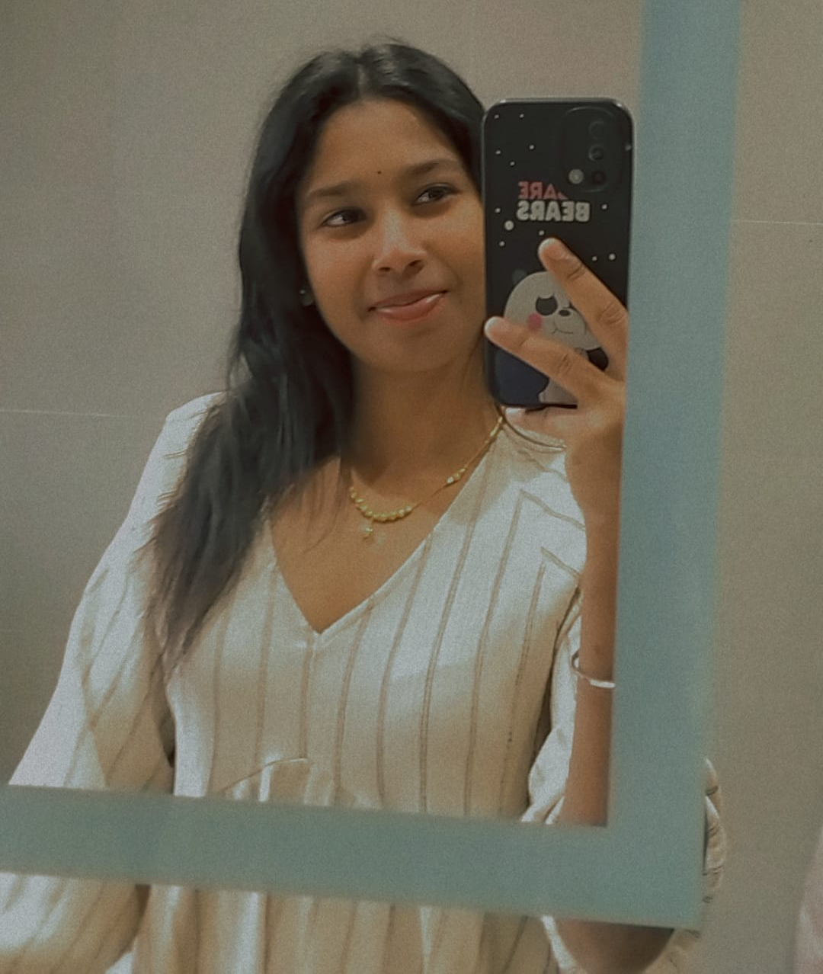
About me
Hi! My name is Virosshny Sorubanantham, and I’m a 20-year-old from Malaysia. I am currently pursuing my studies at the University of South Wales, where I am in my first year of studying Computer Science. I have always been fascinated by technology and its potential to transform the world we live in. This passion has driven me to pursue a career in computer science, as it allows me to explore and understand how technology can be used to solve real-world challenges.

Slide 5
02
What I’m Doing

Slide 6
What I’m Doing
I am a student currently studying Computer Science at the University of South Wales. I am actively exploring various cybersecurity tools and concepts, learning to code in multiple programming languages, and keeping myself updated with the latest trends and advancements in technology. Additionally, I am working on personal projects, such as Python coding, game development, and C++ programming, to apply the knowledge I gain. This process helps me enhance my technical expertise and develop practical skills essential for solving real-world challenges. Moreover, I do have go through with several projects as well.

Slide 7
Skills
03

Slide 8
Skills
Programming and Development
* Python
* Java
* C++
Software Development
* Visual Studio

Slide 9
Hobbies

Slide 10
As a computer science student, I have several hobbies that reflect my diverse interests. On the tech side, I enjoy coding for fun, which involves building personal projects and creating games that challenge my creativity and problem-solving skills. Outside of technology, I engage in outdoor activities such as playing badminton, which helps me stay active and balance my screen time. Additionally, I have a passion for cooking and baking, which I find to be a creative and hands-on way to relax and unwind. These hobbies allow me to maintain a well-rounded lifestyle.

Slide 11

Projects

Slide 12



Projects
01
02
03
Python
Java
C++

Slide 13
Projects I Have Done
C++
Monthly Income | Marks | Winning Division | Balls
Height In Meters | Coin Toss | Time 24 Hours | Occurrences
Annual Temperatures | Triangle | Students Class Performance | Lottery
Letter Shape | Rain Fall | Grades | Test Score #1
Burger Stall | Average Speed | Identical Arrays | Movie Profits

Slide 14

Thank You!

